Slide 1

Lesson 5-1
Pushdown Automata
PDAs
Theory of Computation
王轩
Wang Xuan

Slide 2
Outline
Formalities for PDAs
Pushing & Popping Strings
Non-Determinism
Example PDA
Accept and Reject

Slide 3
History of PDA
Since 1968, millions of computer science students have taken a course on algorithms and data structures, typically the second course after the initial one introducing programming. One of the basic data structures in such a course is the stack.
The stack has a special place in the emergence of computing as a science, as argued by Michael Mahoney, the pioneer of the history of the theory of computing: “Between 1955 and1970, a new agenda formed around the theory of automata and formal languages, which increasingly came to be viewed as foundational for the field as a whole”. In this process, interest arose in “devices with more generative power than finite automata, and more special structure than Turing machines."
The push-down automaton which is based on a stack is such a device.

Slide 4
History of PDA
The importance of the stack in the development of computer science has been explained by Chomsky and Miller in terms of the push-down storage automaton (PDA).
This is an automaton with one read-only input tape moving in one direction only, and one storage tape, movable in both directions. Symbols are written and read on the storage tape, which is used as a push-down storage/ stack with only one symbol visible at a time.
It has been said that “…the theory of push-down automata is, in fact, essentially another version of the theory of context free grammar”. The PDA automaton was introduced by Newell et al in 1959.6

Slide 5
History of PDA
More specifically,
The notion of the 'push-down store' was introduced by Newell, Shaw, and Simon(1959).
The first formulation of the relationship between push-down automata and formal languages is that of Oettinger(1961).
The relationship between context-free grammars and push-down automata was formulated by Chomsky(1963) and Evey(1963) more or less independently.
The equivalence of deterministic push-down automata and LR-grammars was proven by Knuth(1965).

Slide 6
Pushdown Automaton -- PDA
Input String
Stack
States

Slide 7


Initial Stack Symbol
Stack
Stack
stack
head
top
bottom
special symbol
Appears at time 0

Slide 8
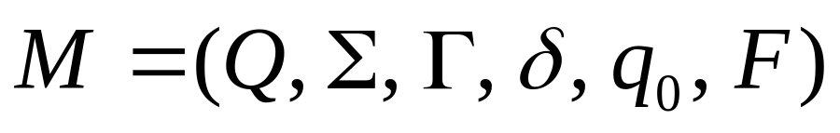
Formal Definition
Pushdown Automaton (PDA)
Accept
states
States
Input
alphabet
Transition
function
Initial
state
Stack
alphabet

Slide 9
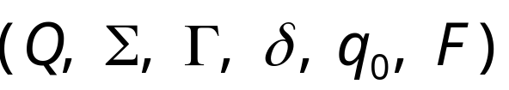
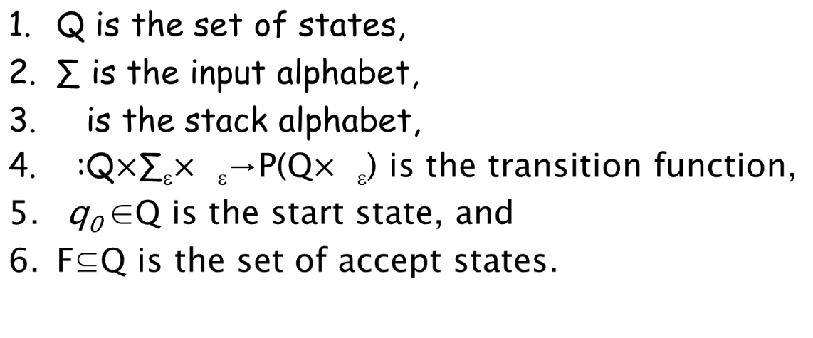


A pushdown automaton is a 6-tuple

Slide 10
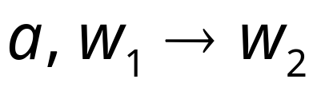


Pushing & Popping Strings
Pop
string
Input
symbol
Push
string

Slide 11







input
stack
top
top
Replace

Slide 12
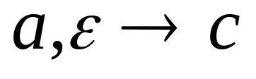
input
stack
top
top
Push

Slide 13
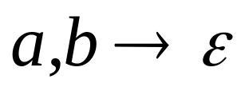
input
stack
top
Pop
top

Slide 14


input
stack
top
No Change
top

Slide 15
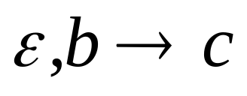

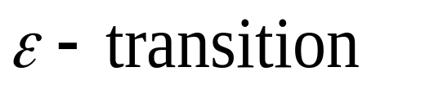
Non-Determinism
PDAs are non-deterministic
Allowed non-deterministic transitions

Slide 16
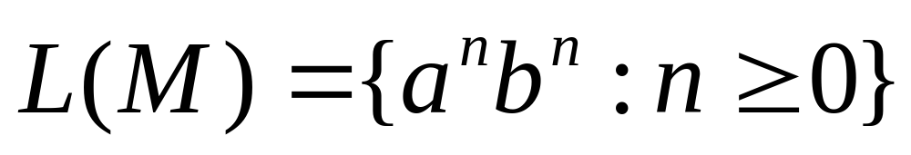


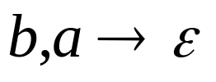

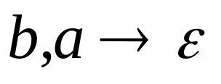
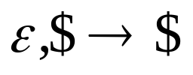

Example PDA
PDA :

Slide 17



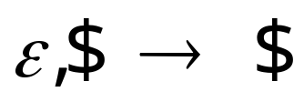
Basic Idea:
Push the a’s
on the stack
2. Match the b’s on input
with a’s on stack
3. Match
found

Slide 18



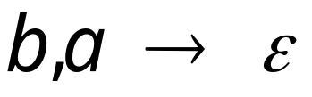


Execution Example:
Time 0
Input
Stack
current
state

Slide 19

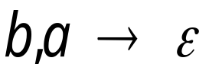



Time 1
Input
Stack

Slide 20


Time 2
Input
Stack

Slide 21
Time 3
Input
Stack

Slide 22
Time 4
Input
Stack

Slide 23




Time 5
Input
Stack

Slide 24
Time 6
Input
Stack

Slide 25
Time 7
Input
Stack

Slide 26
Time 8
Input
Stack
accept

Slide 27
A string is accepted if there is
a computation such that:
All the input is consumed
AND
The last state is an accepting state
we do not care about the stack contents
at the end of the accepting computation

Slide 28
Rejection Example:
Time 0
Input
Stack
current
state

Slide 29
Rejection Example:
Time 1
Input
Stack
current
state

Slide 30
Rejection Example:
Time 2
Input
Stack
current
state

Slide 31
Rejection Example:
Time 3
Input
Stack
current
state

Slide 32
Rejection Example:
Time 4
Input
Stack
current
state

Slide 33
Rejection Example:
Time 4
Input
Stack
reject
current
state

Slide 34
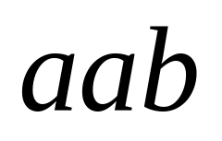
There is no accepting computation for
The string is rejected by the PDA

Slide 35

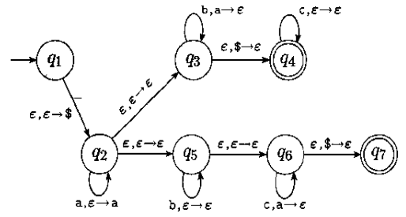
Example
PDA recognizes language

Slide 36
Review
Formalities for PDAs
Pushing & Popping Strings
Non-Determinism
Example PDA
Accept and Reject

